Slide 1

SMART INDIA HACKATHON 2026
TITLE PAGE
Problem Statement ID – 26101
Problem Statement Title - Develop an AI enabled learning platform that identifies competency gaps, recommends personalized training through integration with the iGOT Karmayogi ecosystem, and capable of generating Quizzes and Multiple choice questions (MCQs) from uploaded learning materials to strengthen capacity building in India's Official Statistical System.
Theme- Smart Education
PS Category- Software
Team ID- 35B333
Team Name (Registered on portal) – Logic_Unlocked
Notes:
Good morning everyone.
We are Team Logic_Unlocked, and our problem statement is 26101, given by the Ministry of Statistics and Programme Implementation.
The problem is about building an AI-enabled learning platform for India's Official Statistical System.
In simple terms, our goal is to help government officials understand what skills they currently have, where they have skill gaps, and what they should learn next.
And the main idea behind our solution is simple:
We want to move from one-time training to continuous competency development.
So first, let's understand what is missing in the current training approach.

Slide 2
IDEA TITLE
Logic_
Unlocked
From Static Training to Competency Intelligence
TODAY — WHAT'S BROKEN
One-time certificate
Unexplained scoring
Keyword course search
No feedback loop
Score is frozen after a course - never updates as skills change.
A single number, with no explanation of which skill is weak or why.
Generic keyword matching, not matched to the actual competency gap.
Assessment and learning stay disconnected — no assess → learn → retest cycle.
OUR LOOP — THE CORE IDEA
ASSESS
→
IDENTIFY GAP
→
RECOMMEND
→
LEARN
→
TEST
→
REASSESS
continuous loop — reassess feeds straight back into assess
WHY WE'RE DIFFERENT
Living Competency Profile
Explainable Gap Engine
Closed-Loop Personalisation
Auto-updates after every course — never a stale one-time certificate.
Shows which competency is weak and why — not a black-box number.
Unifies assess → learn → test → reassess in one continuous system.
Notes:
Today, government officials go through different training programmes and courses.
But completing a course does not necessarily tell us what the person has actually become good at, or what skill they still need to improve.
We identified four major challenges.
The important point is that our system doesn't stop after training. It learns from the result of training and decides what should happen next.
Now let me explain how we technically implement this.

Slide 3
TECHNICAL APPROACH
Logic_
Unlocked
System Architecture
USER / OFFICIAL
FRONTEND
React.js — role-based dashboards, Bhashini multilingual UI
PROFILE COLLECTION
BACKEND
SKILL ASSESSMENT
Node.js + Express — REST APIs
AI COMPETENCY ENGINE
DATA
NLP MAP
GAP ENGINE
MCQ ENGINE
(Human review system)
MongoDB — profiles, skills, courses, assessments
AI COURSE MATCHING
AI / ML
iGOT / NSSTA RECOMMENDATION
Python — NLP, gap engine, LLM based MCQ generation, recommender
LEARN + TEST
SECURITY
REASSESS
JWT + RBAC, SSO-ready with iGOT · DPDP aligned, audit logs
Notes:
We use NLP and AI to understand both the learner information and the learning content.
Finally, the competency profile is updated through reassessment.
DPDP = Digital Personal Data Protection.
In India, the Digital Personal Data Protection Act, 2023 (DPDP Act) is the law dealing with processing and protection of people's digital personal data.
We are not trying to replace iGOT. iGOT provides the learning ecosystem, while Skillify adds the competency and assessment intelligence layer around it.
Now the question is — can this actually be built and deployed?

Slide 4
FEASIBILITY AND VIABILITY
Logic_
Unlocked
TECHNICAL FEASIBILITY
DEPLOYMENT VIABILITY
• Proven open-source stack — React, Node.js, MongoDB, Python
• Low technical risk — built using proven AI, assessment and recommendation techniques
• JWT + RBAC security, SSO-ready with iGOT
• Designed with DPDP requirements in mind — encrypted personal data and audit logs
• Designed for integration with authorized iGOT APIs/interfaces
• Bhashini API already live — no new government procurement needed
• Cloud-ready — deployable on suitable government infrastructure
TECHNICAL RISKS → MITIGATION
OPERATIONAL RISKS → MITIGATION
iGOT API rate limits
Data privacy concerns
→ Regularly updated course catalogue keeps recommendations available
→ DPDP aligned design, full audit logs
MCQ quality drift
Cold-start on new officials
→ LLM generation + human review , maintaining transparency
→ Cold-start → role-based baseline + initial assessment
WHY FEASIBLE
Proven technology + existing government infrastructure (iGOT, Bhashini) + established competency frameworks (NSQF, DoPT) — same engine scales to any ministry or state bureau.
Notes:
DPDP = Digital Personal Data Protection.
In India, the Digital Personal Data Protection Act, 2023 (DPDP Act) is the law dealing with processing and protection of people's digital personal data.
Now let's look at what impact this creates for the learner, trainer and government.

Slide 5
IMPACT AND BENEFITS
Logic_
Unlocked
CONVENTIONAL / STATIC WORKFLOW
SKILLIFY
Skill profile
— Static one-time certificate
✓ Living score — updates after every course
Gap visibility
— Single opaque score
✓ Explainable — which skill, and why
Course discovery
— Basic keyword search
✓ AI course-matching
Assessment creation
— Manual quiz-building by trainers
✓ Auto-MCQ from trainers' own content
Language access
— Largely single-language
✓ Bhashini — Hindi + 10 languages
Learning cycle
— One-off assess, then stop
✓ Closed loop — assess → learn → test → reassess
Deployment
— Often licensed
✓ Open-source, GovCloud-ready
WHO BENEFITS
Officials / Learners
Trainers / Admins
Government / National
Personalised gap report
More relevant course recommendation
Multilingual self-assessment
Instant AI-generated MCQs
Organization wide skill gap view
Data-driven training decisions
Better utilisation of iGOT resources
Future-ready statistical workforce
Aligned with Mission Karmayogi
FROM ONE-TIME CERTIFICATION → TO CONTINUOUS COMPETENCY DEVELOPMENT
Personalised upskilling. Less redundancy. Continuous capacity building.
Notes:
Finally, let me show you what we already have as the foundation for this solution.

Slide 6
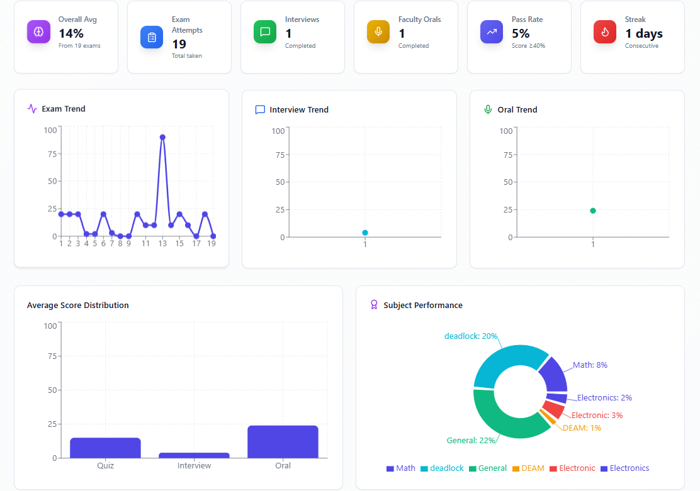
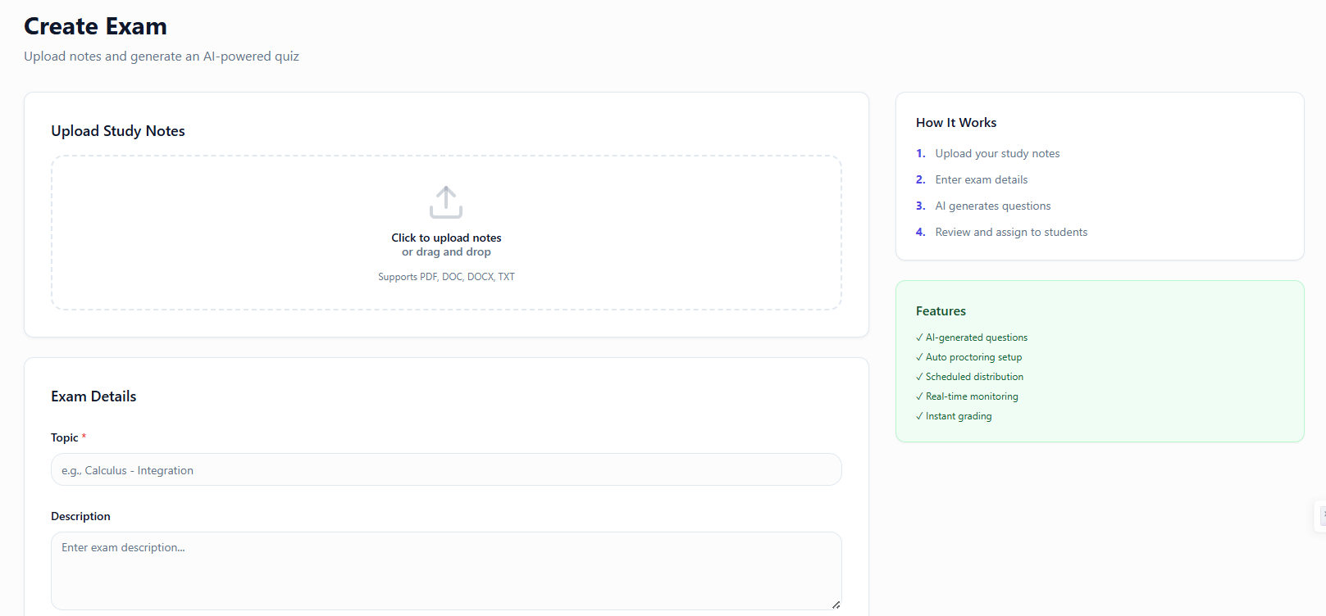
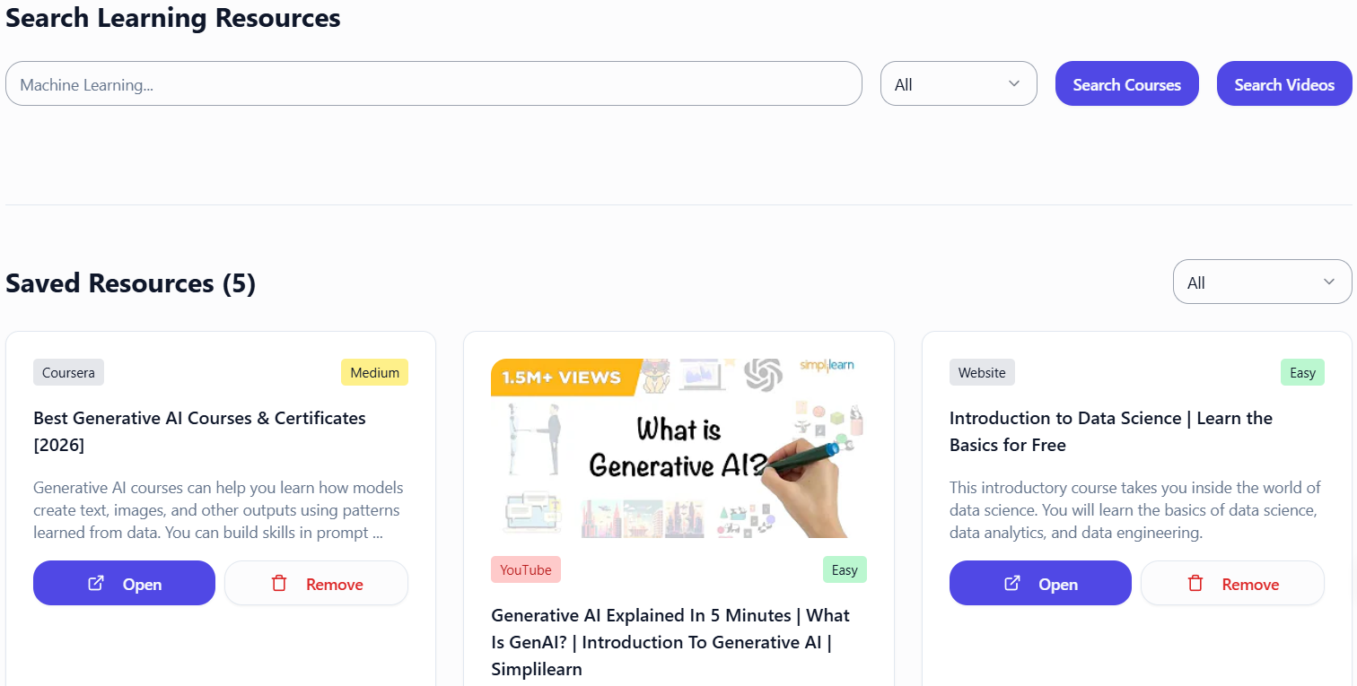
PROTOTYPE / EXISTING FOUNDATION
Logic_
Unlocked
Existing Skillify modules demonstrating the technical foundation for our proposed SIH solution
SCREENSHOT
placeholder
Existing Skillify — Learner Dashboard
SIH: Government Official competency dashboard
Existing Skillify – Exam creation
SIH: Trainer uploads material → AI-generated MCQs
Existing Skillify — Course Discovery
SIH: Competency-based iGOT / NSSTA recommendations
Notes:
We are not starting this project completely from scratch.
Our team has already developed Skillify, an AI-enabled learning platform, and these screenshots show some of the existing modules that form the technical foundation for our SIH solution.
To summarize, Skillify brings everything into one continuous cycle:
And as we are not starting from zero and we do have experience in building this kind of softwares so we think we have a head start and try to achieve the best and efficient solution for this problem.
Thank you. We are happy to take your questions.

